Slide 1
Module-1
Introduction to Finite Automata

Slide 2
Models of Computation

Slide 3
Computation
CPU
memory

Slide 4
temporary memory
input memory
CPU
output memory
Program memory

Slide 5
Example:
temporary memory
input memory
CPU
output memory
Program memory
compute
compute

Slide 6
temporary memory
input memory
CPU
output memory
Program memory
compute
compute

Slide 7
temporary memory
input memory
CPU
output memory
Program memory
compute
compute

Slide 8
temporary memory
input memory
CPU
Program memory
output memory
compute
compute

Slide 9
Automata theory is the study of abstract machines and automata.
The computational problems can be solved using them.
It is a theory in theoretical computer science and discrete mathematics

Slide 10
Automaton
temporary memory
Automaton
input memory
CPU
output memory
Program memory

Slide 11
Different Kinds of Automata
Automata are distinguished by the temporary memory
  Finite Automata: no temporary memory
  Pushdown Automata: stack
  Turing Machines: random access memory

Slide 12
Finite Automaton
temporary memory
Finite
Automaton
input memory
output memory
Example: Vending Machines (small computing power)

Slide 13
Pushdown Automaton
Stack
Push, Pop
Pushdown
Automaton
input memory
output memory
Example: Compilers for Programming Languages
(medium computing power)

Slide 14
Turing Machine
Random Access Memory
input memory
Turing
Machine
output memory
Examples: Any Algorithm (highest computing power)

Slide 15
Power of Automata
Finite
Automata
Pushdown
Automata
Turing
Machine
Less power
Solve more
computational problems
More power

Slide 16
Applications of finite automata
For the designing of lexical analysis of a compiler which breaks the input text into logical units like identifiers, keywords etc.
For recognizing the pattern using regular expressions.
For the designing of the combination and sequential circuits.
Software for designing and checking the behavior of digital circuits.
Used in text editors.
For the implementation of spell checkers.
Software for scanning large bodies of text like web pages to find occurrence of words, phrases and other patterns.
Software to verify all types that have finite number of distinct states such as communications protocols for secure exchange of information.

Slide 17
Applications of Push Down Automata
For designing the parsing phase of a compiler (Syntax Analysis).
For implementation of stack applications.
For evaluating the arithmetic expressions.
For solving the Tower of Hanoi Problem.

Slide 18
Applications of Turing machine
For solving any recursively enumerable problem.
For understanding complexity theory.
For implementation of neural networks.
For implementation of Robotics Applications.
For implementation of artificial intelligence.

Slide 19
General Concepts of Automata Theory
Symbol
Alphabet
Strings
Empty Strings
Length of the string
Power of an Alphabet
Concatenation of two strings
Languages

Slide 20
Alphabets and Strings
Symbol: a, b, 1 ,2, 3, 0, etc.
We will use small alphabets:
Strings

Slide 21
String Operations
1. Concatenation

Slide 22
2.Reverse
3. String Length
Examples:
Length:

Slide 23
4. Length of Concatenation
Example:

Slide 24
5. Empty String
A string with no letters: or ϵ
Observations:

Slide 25
6. Substring
Substring of string:
  a subsequence of consecutive characters
String Substring

Slide 26
7. Prefix and Suffix
Prefixes Suffixes
prefix
suffix

Slide 27
8. Another Operation
Example:
Definition:

Slide 28
9. The * Operation
the set of all possible strings from alphabet

Slide 29
10. The + Operation
: the set of all possible strings from
alphabet except

Slide 30
Languages
A language is a set of strings
String: A sequence of letters
  Examples: “cat”, “dog”, “house”, …
  Defined over an alphabet:

Slide 31
A language is any subset of
Example:
Languages:

Slide 32
Note that
Sets
Set size
Set size
String length

Slide 33
Another Example
An infinite language

Slide 34
Operations on Languages
1. The usual set operations
Complement:

Slide 35
2. Reverse
Definition:
Examples:

Slide 36
3.Concatenation
Definition:
Example:

Slide 37
4. Another Operation
Definition:
Special case:

Slide 38
More Examples

Slide 39
5. Star-Closure (Kleene *)
Definition:
Example:

Slide 40
6. Positive Closure
Definition:

Slide 41
Language Recognizers : An example of Finite Automata
An automaton is an abstract model of a digital computer.
Finite Automata(FA) is the simplest machine to recognize patterns.

Slide 42
Finite Automaton
Input
String
Output
“Accept”
or
“Reject”
Finite
Automaton

Slide 43
Representation of Finite Automata
Finite Automata is represented by –
      Transition Graph
      Transition Table
      Regular Expression

Slide 44
Transition Graph
initial
state
accepting
state
state
transition

Slide 45
Initial Configuration
Input String

Slide 46
Reading the Input

Slide 50
Input finished
accept

Slide 51
Rejection

Slide 55
Input finished
reject

Slide 56
Another Rejection

Slide 57
reject

Slide 58
Another Example

Slide 62
Input finished
accept

Slide 63
Rejection Example

Slide 67
Input finished
reject

Slide 68
Languages Accepted by FAs
Definition:
  The language contains
  all input strings accepted by
  = { strings that bring
  to an accepting state}

Slide 69
Example
accept

Slide 70
Example
accept
accept
accept

Slide 71
Example
trap state/
dead state
accept

Slide 72
Formal Definition
Finite Automaton (FA)
: set of states
: input alphabet
: transition function
: initial state
: set of accepting states

Slide 73
Input Alphabet

Slide 74
Set of States

Slide 75
Initial State

Slide 76
Set of Accepting States

Slide 77
Transition Function

Slide 81
Transition Table

Slide 82
Extended Transition Function

Slide 86
Observation: if there is a walk from to
with label then

Slide 87
Example: There is a walk from to
with label

Slide 88
Recursive Definition

Slide 90
Check the string acceptance of abba
δ*(qo,abba)= δ(δ*(q0,abb) , a)
= δ(δ (δ*(q0,ab),b) , a)
= δ(δ (δ (δ*(q0,a),b),b) , a)
= δ(δ (δ (δ (δ*(q0,λ),a),b),b) , a)
= δ(δ (δ (δ (q0,a),b),b) , a)
=δ(δ (δ (q1,b),b) , a)
=δ(δ (q2,b) , a)
=δ(q3, a)
=q4 Є F
String abba is accepted as q4 is a final state

Slide 91
Language Accepted by FAs
For a FA
Language accepted by :

Slide 92
Example
= { all strings with prefix }
accept

Slide 93
L=strings with substring ‘101’ over {0, 1}

Slide 94
Example
= { all strings without
substring }

Slide 95
Example

Slide 96
Regular Languages
Definition:
A language is regular if there is
FA such that
Observation:
All languages accepted by FAs
form the family of regular languages

Slide 97
Examples of regular languages:
{ all strings with prefix }
{ all strings without substring }
There exist automata that accept these
Languages

Slide 98
There exist languages which are not Regular:
Example:
There is no FA that accepts such a language
(we will prove this later in the class)

Slide 99
Deterministic Finite Automata
Every State should have transition over every input symbol
There should be only One next state for each transition
DFA is defined as

Slide 100
DFA Example
Design DFA that accepts language L= { w : |w| mod 3 = 0 }
over ∑ = {a, b}
Solution
Strings accepted= {ϵ, aaa, bbb, aba, aab, bab, aaabbb, ababab, …}
Strings rejected= {a, b, ab, ba, abab, baba, bbaa, aaabb, …}
Transition Diagram

Slide 101
DFA Example
Consider Sample String : a a b

Slide 102
DFA Example
Consider Sample String : a a b

Slide 103
DFA Example
Consider Sample String : a a b

Slide 104
DFA Example
Consider Sample String : a a b
String is accepted
Acceptance State

Slide 105
DFA Example
Consider Another Sample String : b a b a

Slide 106
DFA Example
Consider Another Sample String : b a b a

Slide 107
DFA Example
Consider Another Sample String : b a b a

Slide 108
DFA Example
Consider Another Sample String : b a b a

Slide 109
DFA Example
Consider Another Sample String : b a b a
String is rejected
Rejection State

Slide 110
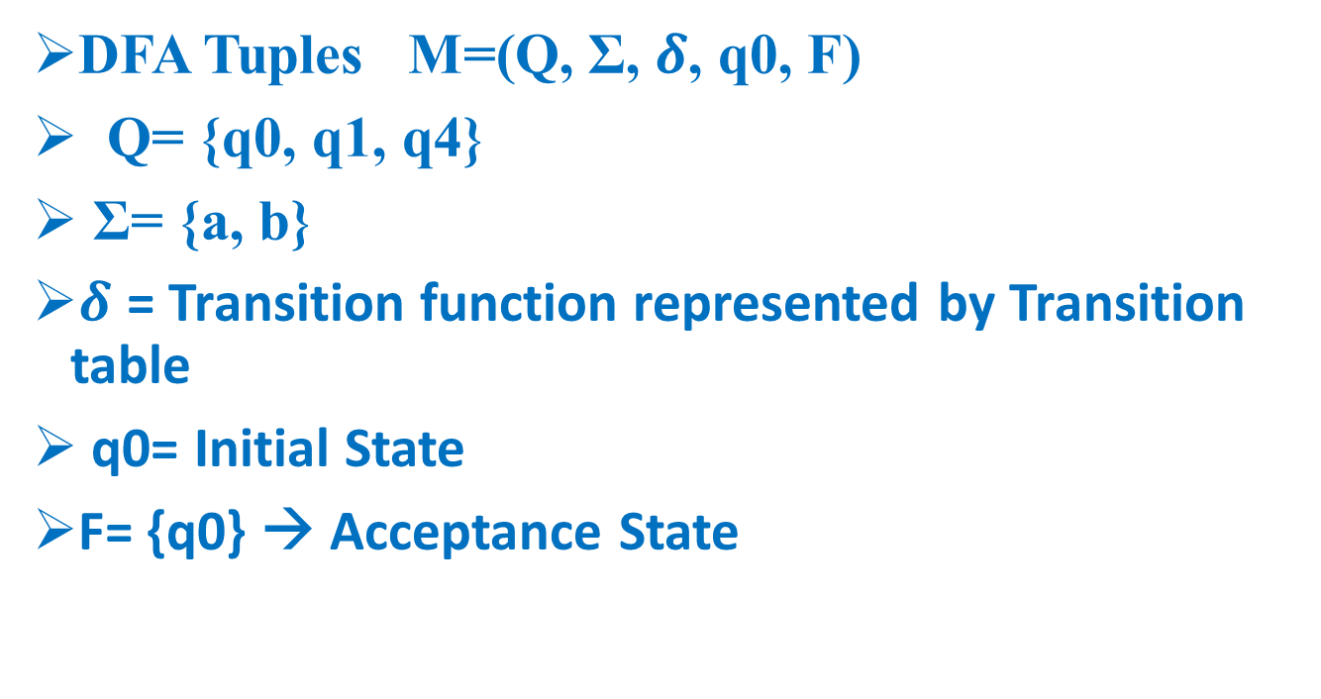
DFA Example
DFA Tuples M=(Q, Σ, $δ$, q0, F)
Q= {q0, q1, q4}
Σ= {a, b}
$δ$ = Transition function represented by Transition table
q0= Initial State
F= {q0} → Acceptance State

Slide 111
DFA Example
Transition Table
Σ Q | a | b
*q0 | q1 | q1
q1 | q4 | q4
q4 | q0* | q0*

Slide 112
DFA - Starts with a , ∑={a,b}
L= { a,aa,ab,aaa,aab,aba,….}
a,b
a
q0
q1
b
q2
a,b

Slide 113
DFA - Starts with ab , ∑={a,b}
L= { ab,aba,abb,….}
a,b
a
b
q0
q1
q2
b
a
q3
a,b

Slide 114
DFA - Starts with aa , ∑={a,b}
L = { aa,aab,aaba,….}
a,b
a
a
q1
q2
q0
b
b
q3
a,b

Slide 115
DFA - Starts with aba , ∑={a,b}
L={ aba,abaa,abab,abaaa,…}
a,b
a
b
a
q0
q1
q2
q3
a
b
b
q4
a,b

Slide 116
DFA - Starts with 101 , ∑={0,1}
L={ 101,1010,1011,101101,…}
0,1
1
0
1
q0
q1
q2
q3
1
0
0
q4
0,1
116

Slide 117
Ends with a
L={a,aa,ba,aaa,aba,…}
b
a
a
q0
q1
b

Slide 118

L={ 1,01,11,…}
0
1
1
q0
q1
0

Slide 119
Ends with ab
L={ab,aab,bab,aaab,bbbbab,abab,…}
b
a
a
b
a
q2
q0
q1
a
b

Slide 120
Ending with bab
b
a
b
b
a
b
q0
a
q3
q1
q2
a
a
120

Slide 121
DFA – Ends with 101, ∑={ 0,1}
L={ 101,0101,1101,000101,111101,…}
1
0
1
0
0
1
1
q1
q2
q3
q0
0

Slide 122
DFA – Ends with 111 , ∑={ 0,1}
L= { 111,0111,11111,…}
0
0
1
1
1
1
q1
q0
q2
q3
0
0

Slide 123
DfA – Substring 101
L={ 101,0101,1101,1010,1011,00010111,…}
0
1
0,1
1
0
1
q1
q2
q3
q0
0

Slide 124
DFA- Contains 111
L={ 111,0111,1111,000111000,11111000,..}
0
0,1
1
1
1
q0
q1
q2
q3
0
0

Slide 125
DFA – Contains 1011
L= { 1011,01011,11011,00010111,..}
0
1
0,1
1
0
1
1
q0
0
0

Slide 126
DFA- Even no of 0s, ∑={ 0,1} or n0(w)mod2=0
L={ λ, 1,1111,00,0000,11100,1110000,0000111,..}
1
1
0
q0
q1
Transition | o | 1
*->q0 | q1 | q0
q1 | qo | q1
0

Slide 127
DFA- strings with even number of 0’s over {0, 1}

Slide 128
DFA – Odd no of 0’s , ∑={ 0,1} or n0(w)mod2=1
L={ 0,01,1110,000,000001111,…}
1
1
0
q1
q0
0

Slide 129
DFA - na(w)mod3=0, ∑={ a,b}
L={ λ,bbbb,aaabbb,aaaaaabbb,….}
b
b
b
a
a
a

Slide 130
DFA- nb(w)mod4=1, ∑={ a,b}
a
a
a
a
b
b
b
b

Slide 131
DfA – n1(w)mod3=2, ∑={ 0,1}
0
0
0
1
1
1

Slide 132
Dfa –lwlmod2=0,
a,b
a,b

Slide 133
DfA – lwlmod2=1
L={a,b,aaa,aba,aab,baa,bbb,baba,bba,….
a,b
a,b

Slide 134
DFA –lwlmod3=0, ∑={ 0,1}
a,b
a,b
a,b

Slide 135
DFA : string with even number of 0’s & odd number of 1’s over {0, 1}

Slide 136
No of a’s is even and no of b’s odd-eo
a
oe
ee
a
b
b
b
b
a
eo
oo
a

Slide 137
No of a’s is odd and no of b’s even=oe
a
oe
ee
a
b
b
b
b
a
eo
oo
a

Slide 138
No of a’s is odd and no of b’s odd-oo
a
oe
ee
a
b
b
b
b
a
eo
oo
a

Slide 139
No of a’s is even and no of b’s even-ee
a
ee
oe
a
b
b
b
b
a
eo
oo
a

Slide 140
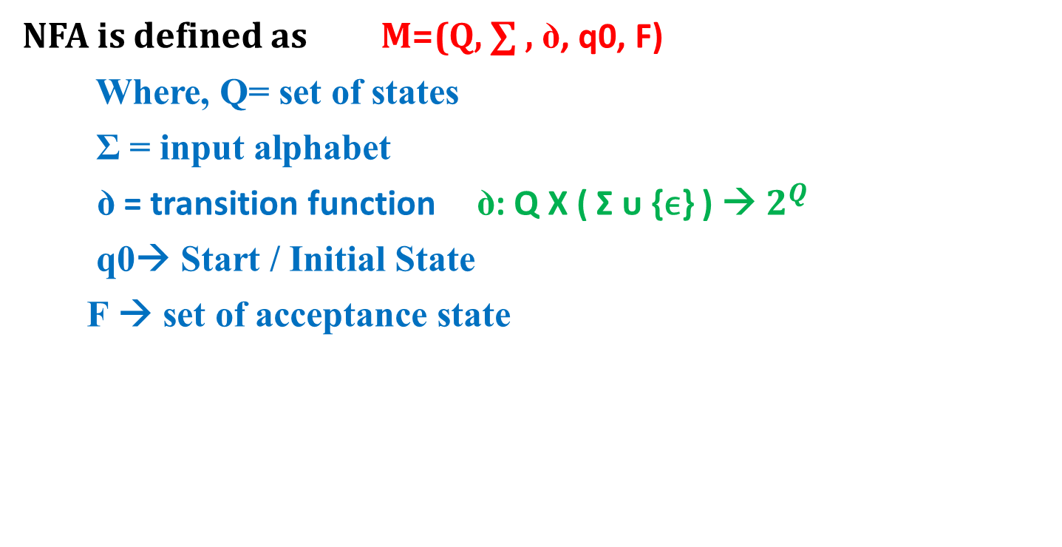
NFA Definition
NFA is defined as M=(Q, ∑ , ꝺ, q0, F)
Where, Q= set of states
Σ = input alphabet
ꝺ = transition function ꝺ: Q X ( Σ ᴜ {ϵ} ) → $2^{Q}$
q0→ Start / Initial State
F → set of acceptance state

Slide 141
NFA Example
Design NFA that accepts language of strings ending with ab/ba over ∑ = {a, b}
Solution
Strings accepted= {ab, ba, abab, baba, bbab, aaaba, …}
Strings rejected= {ϵ, a, b, aa, bb, aaa, abb, aaabbb, …}
Transition Diagram

Slide 142
NFA to DFA Conversion Example
Convert NFA to DFA that accepts language of strings ending with ab/ba over ∑ = {a, b}
Solution
Draw NFA for given language
Convert that NFA into DFA using subset construction method

Slide 143
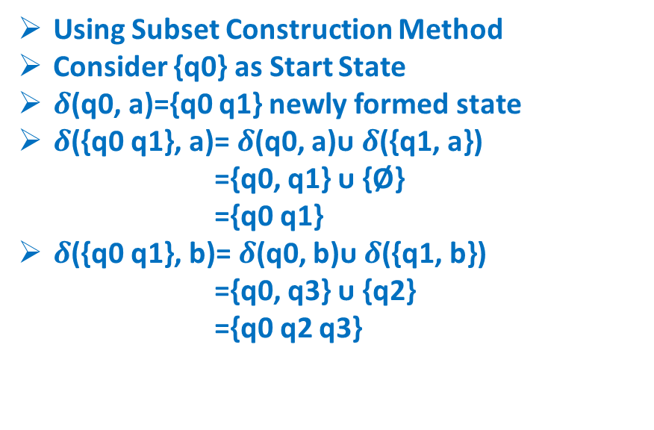
NFA to DFA Conversion Example
Using Subset Construction Method
Consider {q0} as Start State
$δ$(q0, a)={q0 q1} newly formed state
$δ$({q0 q1}, a)= $δ$(q0, a)ᴜ $δ$({q1, a})
={q0, q1} ᴜ {Ø}
={q0 q1}
$δ$({q0 q1}, b)= $δ$(q0, b)ᴜ $δ$({q1, b})
={q0, q3} ᴜ {q2}
={q0 q2 q3}
NFA | a | b
q0 | {q0, q1} | {q0, q3}
q1 | - | {q2}
q2 | - | -
q3 | {q4} | -
q4 | - | -
DFA | a | b
q0 | {q0 q1} | {q0 q3}
{q0 q1} | {q0 q1} | {q0 q2 q3}

Slide 144
NFA to DFA Conversion Example
Using Subset Construction Method
Consider {q0} as Start State
𝜹(q0, a)={q0 q1} newly formed state
𝜹({q0 q1}, a)= 𝜹(q0, a)ᴜ 𝜹({q1, a})
={q0, q1} ᴜ {Ø}
={q0 q1}
𝜹({q0 q1}, b)= 𝜹(q0, b)ᴜ 𝜹({q1, b})
={q0, q3} ᴜ {q2}
={q0 q2 q3}
{q0 q2 q3} is newly formed state
𝜹({q0 q2 q3}, a)= 𝜹(q0, a) ᴜ 𝜹({q2, a}) ᴜ 𝜹({q3, a})
={q0, q1} ᴜ {Ø} ᴜ {q4}
={q0 q1 q4}
𝜹({q0 q2 q3}, b)= 𝜹(q0, b)ᴜ 𝜹({q2, b}) ᴜ 𝜹({q3, b})
={q0, q3} ᴜ {Ø} ᴜ {Ø} ={q0 q3}
NFA | a | b
q0 | {q0, q1} | {q0, q3}
q1 | - | {q2}
q2 | - | -
q3 | {q4} | -
q4 | - | -
DFA | a | b
q0 | {q0 q1} | {q0 q3}
{q0 q1} | {q0 q1} | {q0 q2 q3}
{q0 q2 q3) | {q0 q1 q4} | {q0 q3}

Slide 145
NFA to DFA Conversion Example
{q0 q3} is newly formed state
𝜹({q0 q3}, a)= 𝜹(q0, a)ᴜ 𝜹({q3, a})
={q0, q1} ᴜ {q4}
={q0 q1 q4}
𝜹({q0 q3}, b)= 𝜹(q0, b)ᴜ 𝜹({q3, b})
={q0, q3} ᴜ {Ø}
={q0 q3}
NFA | a | b
q0 | {q0, q1} | {q0, q3}
q1 | - | {q2}
q2 | - | -
q3 | {q4} | -
q4 | - | -
DFA | a | b
q0 | {q0 q1} | {q0 q3}
{q0 q1} | {q0 q1} | {q0 q2 q3}
{q0 q2 q3) | {q0 q1 q4} | {q0 q3}
{q0 q3} | {q0 q1 q4} | {q0 q3}

Slide 146
NFA to DFA Conversion Example
{q0 q3} is newly formed state
𝜹({q0 q3}, a)= 𝜹(q0, a)ᴜ 𝜹({q3, a})
={q0, q1} ᴜ {q4}
={q0 q1 q4}
𝜹({q0 q3}, b)= 𝜹(q0, b)ᴜ 𝜹({q3, b})
={q0, q3} ᴜ {Ø}
={q0 q3}
{q0 q1 q4} is newly formed state
𝜹({q0 q1 q4}, a)= 𝜹(q0, a) ᴜ 𝜹({q1, a}) ᴜ 𝜹({q4, a})
={q0, q1} ᴜ {Ø} ᴜ {Ø}
={q0 q1}
𝜹({q0 q1 q4}, b)= 𝜹(q0, b)ᴜ 𝜹({q1, b}) ᴜ 𝜹({q4, b})
={q0, q3} ᴜ {q2} ᴜ {Ø}
={q0 q2 q3}
NFA | a | b
q0 | {q0, q1} | {q0, q3}
q1 | - | {q2}
q2 | - | -
q3 | {q4} | -
q4 | - | -
DFA | a | b
q0 | {q0 q1} | {q0 q3}
{q0 q1} | {q0 q1} | {q0 q2 q3}
{q0 q2 q3) | {q0 q1 q4} | {q0 q3}
{q0 q3} | {q0 q1 q4} | {q0 q3}
{q0 q1 q4} | {q0 q1} | {q0 q2 q3}

Slide 147
NFA to DFA Conversion Example
DFA | a | b
q0 | {q0 q1} | {q0 q3}
{q0 q1} | {q0 q1} | {q0 q2 q3}
{q0 q2 q3) | {q0 q1 q4} | {q0 q3}
{q0 q3} | {q0 q1 q4} | {q0 q3}
{q0 q1 q4} | {q0 q1} | {q0 q2 q3}

Slide 148
ϵ-NFA Example
ϵ- NFA allows transition on null string or no inputs
It means machine can make transition without input

Slide 149
ϵ-NFA Example
Design ϵ-NFA that accepts language of strings ending with ab/ba over ∑ = {a, b}
Solution
Strings accepted= {ab, ba, abab, baba, bbab, aaaba, …}
Strings rejected= {ϵ, a, b, aa, bb, aaa, abb, aaabbb, …}
Transition Diagram

Slide 150
ϵ-NFA to DFA Conversion Example
Convert the following ϵ-NFA to DFA
Solution
Find ϵ-closure of each state
Convert that ϵ-NFA into DFA using subset construction method

Slide 151
ϵ-NFA to DFA Conversion Example
ϵ- Closure : of a state qi is the set of states including qi, also states having ϵ-transitions from state qi and so on…
ϵ- Closure of state qi includes:
-qi
-set of states reachable from qi over ϵ- move
-set of states reachable from states of state qi over ϵ- move and so on…

Slide 152
ϵ-NFA to DFA Conversion Example
ϵ-closure of state is define as a set of states that includes
- that state itself
- set of states reachable from state Q over ϵ-transaction
- set of states reachable from existing states in ϵ-closure over ϵ-transaction and so on..
States | ϵ-closure
q0 | {q0}
q1 | {q1, q2}
q2 | {q2}

Slide 153
ϵ-NFA to DFA Conversion Example
Using Subset Construction Method
Consider ϵ-closure of {q0}= {q0} as Start State
a-successor of {q0}
= ϵ-closure (𝜹(q0, a))
= ϵ-closure ({q0,q1})
= ϵ-closure (q0) ᴜ ϵ-closure (q1)
= {q0} ᴜ {q1, q2}
={q0,q1,q2}
b-successor of {q0}
= ϵ-closure (𝜹(q0, b))={Ø}
DFA | a | b
{q0} | {q0 q1 q2} | {Ø}

Slide 154
ϵ-NFA to DFA Conversion Example
Using Subset Construction Method
Consider {q0 q1 q2} as a new state
a-successor of {q0 q1 q2}
= ϵ-closure (𝜹(q0, a)ᴜ𝜹(q1, a)ᴜ𝜹(q2, a))
= ϵ-closure ({q0 q1}ᴜ{Ø}ᴜ{q2})
= ϵ-closure ({q0 q1 q2})
= ϵ-closure (q0) ᴜ ϵ-closure (q1) ᴜ ϵ-closure (q2)
= {q0} ᴜ {q0, q1} ᴜ {q2}={q0,q1,q2}
b-successor of {q0 q1 q2}
ϵ-closure (𝜹(q0, b)ᴜ𝜹(q1, b)ᴜ𝜹(q2, b))
= ϵ-closure ({Ø}ᴜ{q1 q2}ᴜ{Ø})
= ϵ-closure ({q1 q2})
= ϵ-closure (q1) ᴜ ϵ-closure (q2) = {q1 q2} ᴜ {q2}={q1 q2}
DFA | a | b
{q0} | {q0 q1 q2} | {Ø}
{q0 q1 q2} | {q0 q1 q2} | {q1 q2}

Slide 155
ϵ-NFA to DFA Conversion Example
Using Subset Construction Method
Consider {q1 q2} as a new state
a-successor of {q1 q2}
= ϵ-closure (𝜹(q1, a)ᴜ𝜹(q2, a))
= ϵ-closure ({Ø}ᴜ{q2})
= ϵ-closure ({q2})
= {q2}
b-successor of {q1 q2}
ϵ-closure (𝜹(q1, b)ᴜ𝜹(q2, b))
= ϵ-closure ({q1 q2}ᴜ{Ø})
= ϵ-closure ({q1 q2})
= ϵ-closure (q1) ᴜ ϵ-closure (q2) = {q1 q2} ᴜ {q2}={q1 q2}
DFA | a | b
{q0} | {q0 q1 q2} | {Ø}
{q0 q1 q2} | {q0 q1 q2} | {q1 q2}
{q1 q2 ) | {q2} | {q1 q2}

Slide 156
ϵ-NFA to DFA Conversion Example
Using Subset Construction Method
Consider {q2} as a new state
a-successor of {q2}
= ϵ-closure (𝜹(q2, a))
= ϵ-closure ({q2})
= {q2}
b-successor of {q2}
=ϵ-closure (𝜹(q2, b))
= ϵ-closure ({Ø})
={Ø}
DFA | a | b
{q0} | {q0 q1 q2} | {Ø}
{q0 q1 q2} | {q0 q1 q2} | {q1 q2}
{q1 q2 ) | {q2} | {q1 q2}
{q2} | {q2} | {Ø}

Slide 157
ϵ-NFA to DFA Conversion Example
DFA | a | b
{q0} | {q0 q1 q2} | {Ø}
{q0 q1 q2} | {q0 q1 q2} | {q1 q2}
{q1 q2 ) | {q2} | {q1 q2}
{q2} | {q2} | {Ø}

Slide 158
Minimization of DFA Example
Minimize the following DFA
DFA | 0 | 1
A | B | C
B | B | D
C | B | C
D | B | E
E* | B | C

Slide 159
Minimization of DFA Example
Minimize the following DFA
Use State Equivalence Method
Write 0’Equivalence as
{A, B, C, D} {E}
Write 1’Equivalence
{A, B, C} {D} {E}
Write 2’Equivalence
{A, C} {B} {D} {E}
Write 3’Equivalence
{A, C} {B} {D} {E}
DFA | 0 | 1
A | B | C
B | B | D
C | B | C
D | B | E
E* | B | C

Slide 160
Minimization of DFA Example
Minimize the following DFA
Use State Equivalence Method
Write 0’Equivalence as
{A, B, C, D} {E}
Write 1’Equivalence
{A, B, C} {D} {E}
Write 2’Equivalence
{A, C} {B} {D} {E}
Write 3’Equivalence
{A, C} {B} {D} {E}
DFA | 0 | 1
A,C | B | C
B | B | D
D | B | E
E* | B | C

